Slide 1


Slide 2


Slide 3




BetterCrypto⋅org
Applied Crypto Hardening
David Durvaux
Aaron Kaplan
Brussels, 9th June 2014

Slide 4
Who
Wolfgang Breyha (uni VIE),
David Durvaux (CERT.be),
Tobias Dussa (KIT-CERT),
L. Aaron Kaplan (CERT.at),
Christian Mock (coretec),
Daniel Kovacic (A-Trust),
Manuel Koschuch (FH Campus Wien),
Adi Kriegisch (VRVis),
Ramin Sabet (A-Trust),
Aaron Zauner (azet.org),
Pepi Zawodsky (maclemon.at),
New contributors:
IAIK,
A-Sit

Slide 5
Agenda
Pieces of History
Introduction to BetterCrypto project
Cryptography in a nutshell
Practical Settings
Demo
Conclusion

Slide 6
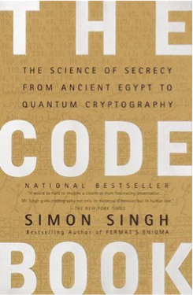
Pieces of History

Slide 7
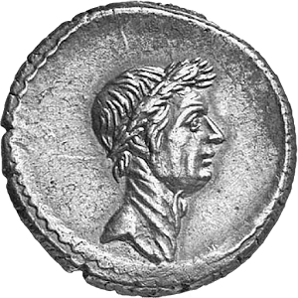
Caesar
Vigenère Cipher

Slide 8
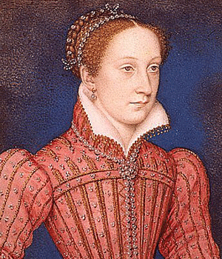
Mary Queen of Scots
Trial against Queen Elizabeth
Was executed after her code was broken (1587)

Slide 9
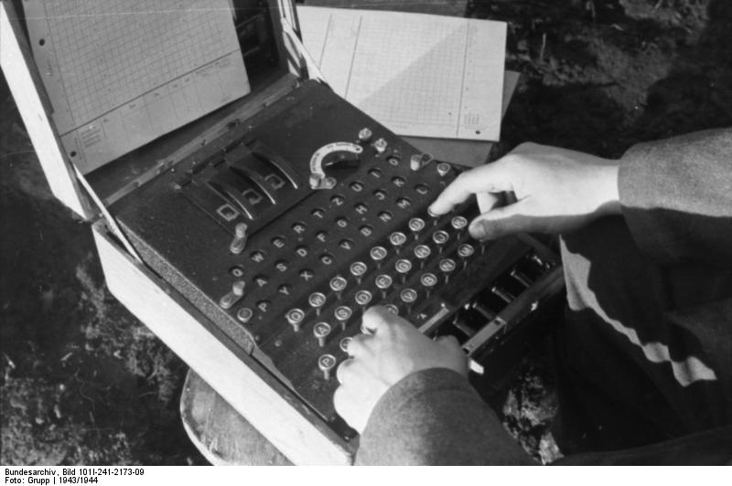
Enigma
Secret in code book

Slide 10
BetterCrypto

Slide 11
Why?
Crypto is cryptic
A lot of difficult concepts
A lot of algorithms
A lot of parameters
…

Slide 12
The Idea
Really difficult for systems administrators
A “cookbook” can help!
That’s BetterCrypo

Slide 13
That’s not…
A crypto course
A static document

Slide 14
In short
Community effort to produce best practices
Continuous effort
Mixed expertises
Open to comments / suggestions / improvements

Slide 15
2 parts
First part = configurations
The most important part
Cover as many tools as possible
Second part = theory
Explain and justify choose we made
Transparency

Slide 16
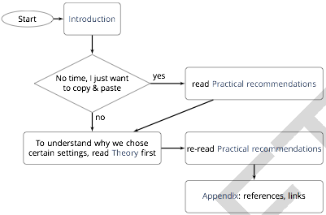
How to use?

Slide 17
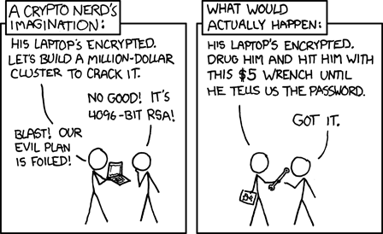
Crypto in a nutshell

Slide 18
Goals
2 types of goals:
protect the contact of the message
identify the author
Can be combined

Slide 19
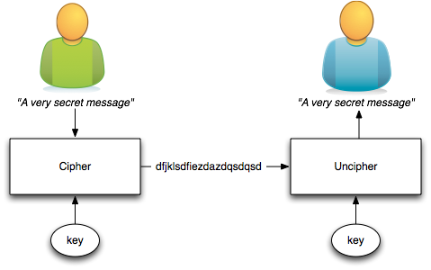
Symetric Ciphering
The key is shared

Slide 20
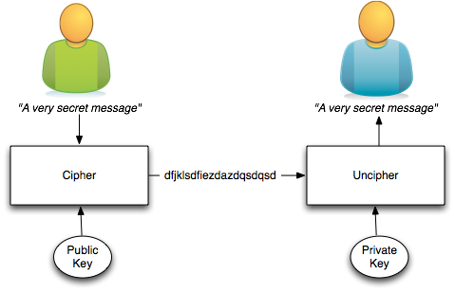
Asymetric Ciphering
Public key is published
Private key HAS to be secured

Slide 21
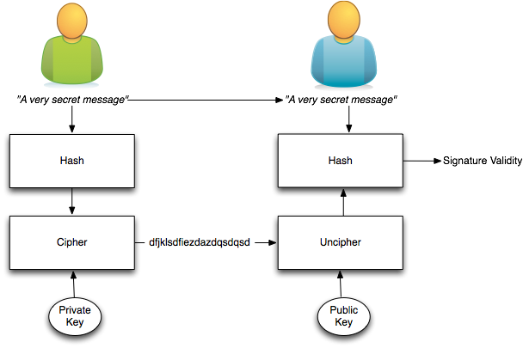
Signing
Author identity is proved

Slide 22
The asymmetric magic
RSA “formula” :
with
c which is the ciphertext
m is the cleartext message
e and n are the public key
Uncipher with
d being the private key

Slide 23
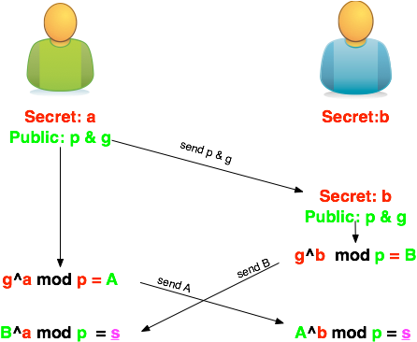
Diffie-Helleman
How to share a secret key?

Slide 24
Ephemeral Diffie-Helleman
Regular mode
Public and private keys are kept
Ephemeral mode
New keys are generated each time
By one of the parties at least

Slide 25
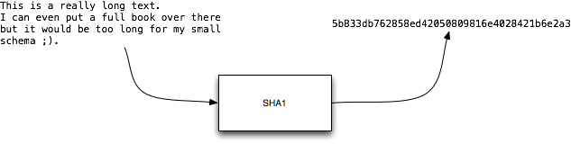
Hashing
Take long piece of data and produce a probably unique signature
Probability of collision for SHA1:
1 over 1461501637330902918203684832716283019655932542976

Slide 26
ECC
Elliptic curve cryptography (ECC)
Finding the discrete logarithm of a random elliptic curve element
Only knowing a base point
Assumed to be infeasible
Reduced key length

Slide 27
Some thoughts on ECC
Currently this is under heavy debate
Trust the Math
“Nothing Up My Sleeve Numbers”
eg. NIST P-256 (http://safecurves.cr.yp.to/rigid.html)
Coefficients generated by hashing the unexplained seed c49d3608 86e70493 6a6678e1 139d26b7 819f7e90.
Might have to change settings tomorrow
Most Applications only work with NIST-Curves

Slide 28
SSL
Explain

Slide 29
Stream vs Block Cipher
Stream cipher
Generate an “infinite” key stream
Difficult to correctly use
Re-use of keys
Faster
Block cipher
Cipher by block with padding
Could include integrity protection

Slide 30
Some algorithms
Symetric Ciphering
DES / 3DES
AES (Rijndael)
Camellia
Asymetric Ciphering
RSA
PGP (GPG)

Slide 31
Some algorithms
Hash
SHA1
SHA256
SHA512
Key Exchange
Diffie Helleman

Slide 32
Algorithm vs Implementation!
Heartbeat

Slide 33
Heartbeat
/* Enter response type, length and copy payload */
*bp++ = TLS1_HB_RESPONSE;
s2n(payload, bp);
memcpy(bp, pl, payload);
payload (pl) and payload_length (payload) are controlled by attacker
memcpy will copy a part of the victim memory to the reply…

Slide 34
BetterCrypto CipherSuite
2 cipher suites
version A
stronger
less supported client
version B
weaker
more “universal”

Slide 35
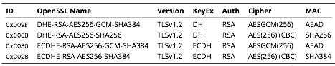
Cipher Suite A
TLS 1.2
Perfect forward secrecy / ephemeral Diffie Hellman
Strong MACs (SHA-2) or
GCM as Authenticated Encryption scheme

Slide 36
CiperSuite B
TLS 1.2, TLS 1.1, TLS 1.0
Allowing SHA-1

Slide 37
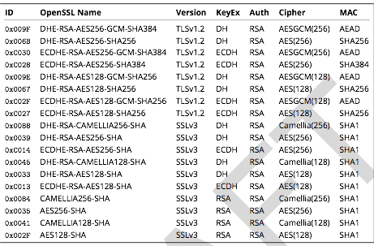
Cipher Suite B

Slide 38
Key Length
On the choice between AES256 and AES128: I would never consider using AES256, just like I don’t wear a helmet when I sit inside my car. It’s too much bother for the epsilon improvement in security.”
— Vincent Rijmen in a personal mail exchange Dec 2013
Symetric
128 bits
Aysmetric
3248 bits (RSA)

Slide 39
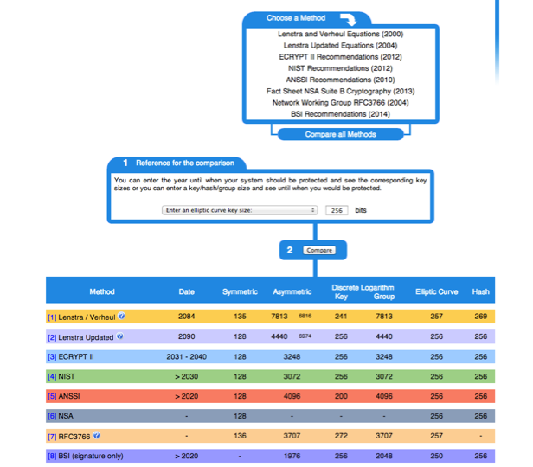

Slide 40
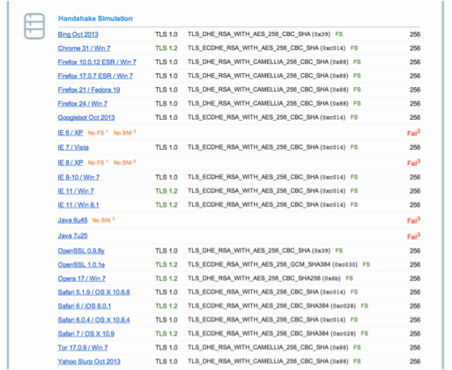
Compatibility (B suite)

Slide 41

Practical Settings

Slide 42
Tools covered
Webservers
Apache
lighttpd
nginx
Microsoft IIS

Slide 43
Tools covered
SSH
Open SSH
Cisco ASA
Cisco IOS

Slide 44
Tools covered
Mail servers
Dovecot
cyrus-imapd
Postfix
Exim

Slide 45
Tools covered
VPN
IPSec
CheckPoint Firewall-1
OpenVPN
PPPTP
Cisco ASA
OpenSWAN
tinc

Slide 46
Tools covered
PGP/GPG
IPMI/ILO
Instant Messaging
ejabberd
OTR
Charybdis
SILC

Slide 47
Tools covered
Database systems
Oracle
MySQL
DB2
PostgreSQL

Slide 48
Tools covered
Proxy
squid
Bluecoat
Pound
Kerberos

Slide 49
Mail Encryption
GPG / PGG
[ a little bit over there ]

Slide 50
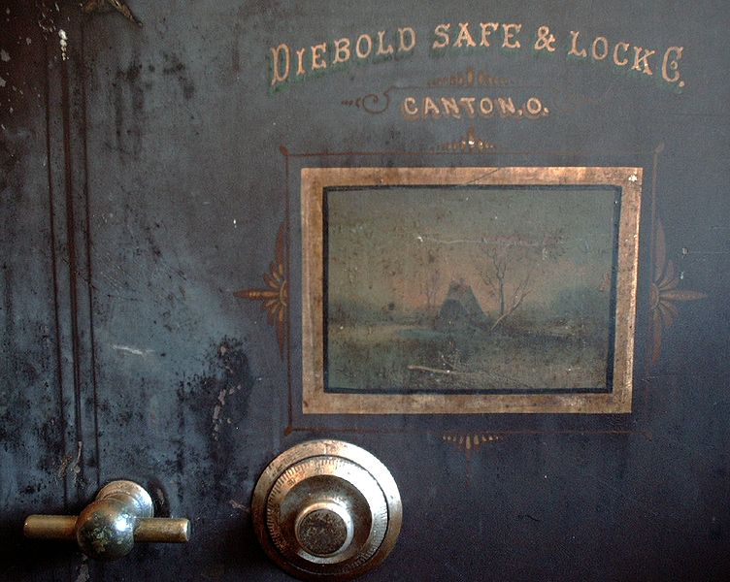
Demo

Slide 51
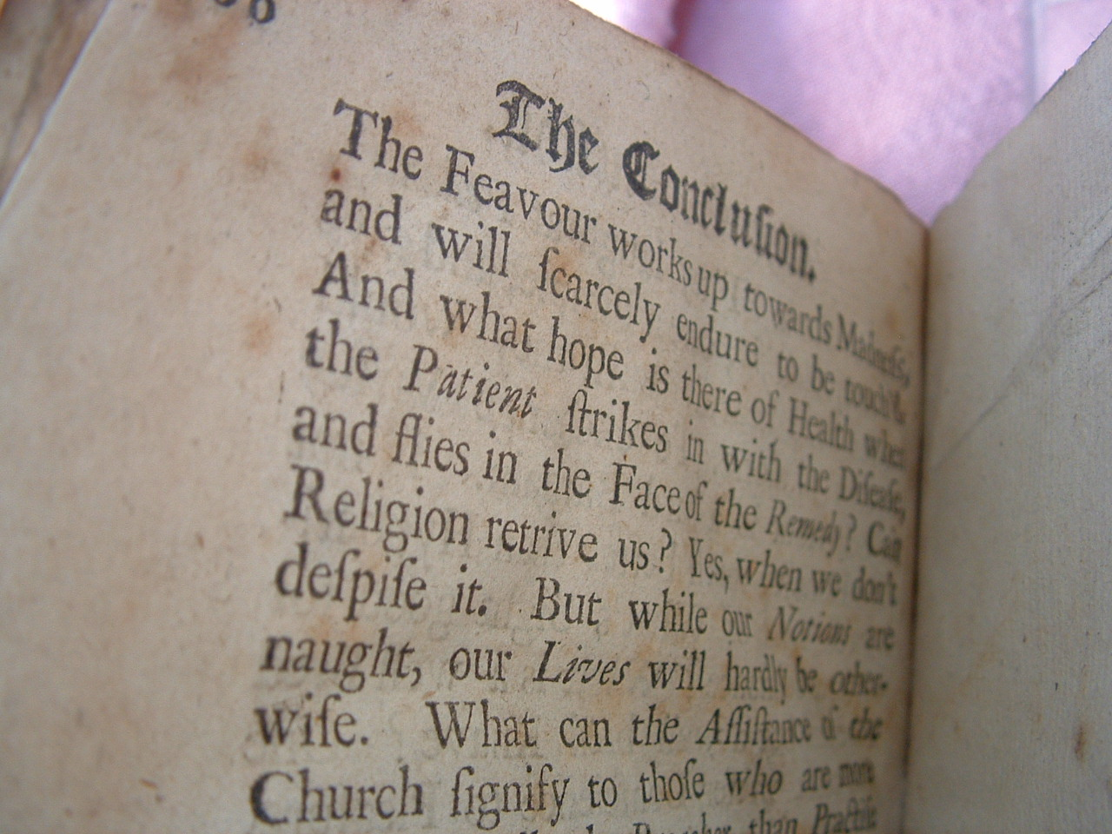
Conclusion

Slide 52
Futur / Idea
Configuration Generator (online)
A friendly copy/paste version
Other tools

Slide 53
Conclusion

Slide 54
References
BetterCrypto.org
https://git.bettercrypto.org/ach-master.git
http://lists.cert.at/cgi-bin/mailman/listinfo/ach
Contact
aaron@XXX.org — [TWITTER]
david@autopsit.org — @ddurvaux

